Slide 1
E.CONTENT
Course name- B.A
Course Year- Sem 5
Name of Paper- Ancient Indian Architecture
Name of Topic-Stupa Architecture
Name of Sub Topic- Origin And Development Of Stupa Architecture
Key words-Stupa, Bharhut, Sanchi
Name of Developer –Dr.Aisha Fatmi
Contact number- 9451721285
Email Id- aisha.fatmi123@gmail.com
College Name- NARI SHIKSHA NIKETAN PG COLLEGE,LUCKNOW
Name of University-LUCKNOW UNIVERSITY ,LUCKNOW

Slide 2

Stupa Architecture in Ancient India (Origin and Development)
Dr. Aisha Fatmi
Associate Professor ,AIH
NSN PG College,
Padmashree Mona Chandravati Marg,
Qaiserbagh, Lucknow
Disclaimer
The E-Content is exclusively meant for academic purposes and for enhancing teaching and learning. Any other use for economic/ Commercial purpose is strictly prohibited. The users of the content shall not distribute, disseminate or share it with anyone else and its use is restricted to advancement of individual knowledge. The information provided in this E-Content is developed from authentic references to the best of my knowledge.

Slide 3
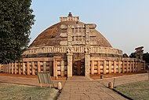
Stupa Architecture in Ancient India (Origin and Development)
en.wikipedia.org.wiki/stupa

Slide 4
Introduction
Meaning of Art- The expression or application of human creative skill and imagination, typically in visual form such as painting ,sculpture , producing works to be appreciated primarily for their beauty or emotional power. It is a form of communication. It means whatever the artist intend to mean.
Three Major forms of Art
Architecture
Sculpture
Painting

Slide 5
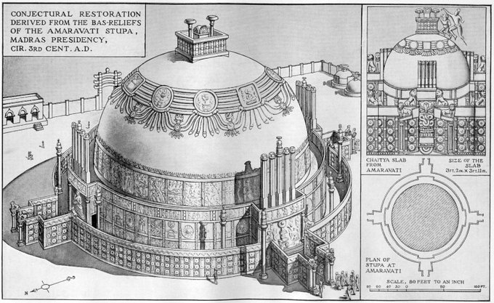
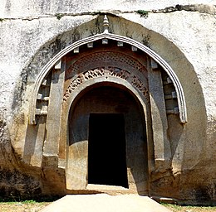
Meaning of Architecture
Architecture/Vastukala/Sthapatya kala
Derived from Vastu – Vasati-to stay
Derived from sthapati-one who stays ,lives at certain place
Latin word Architectus derived from Greek word Archi(who commands)+Tecton(builder)
English word Architecture is derived from these roots
en.wikipedia.org.wiki/lomash-Rishi-Caves
Adivarah@vajrayuddha11,June 3,2018
Lomash Rishi Guha

Slide 6

Some Literary sources of Ancient Indian Architecture
Vrihat samhita
Mansaar
Samarangar Sutradhar
Vishnudharmottar puran
Shilparatna saar
Rupamandan
Agni purana
Matsya purana

Slide 7
Building Architecture
Structural
Rock cut
Secular
Religious
Houses
Palaces
Public building
Stupas
Monastries
Streets
Caves
Temples
Viharas
Chaityas
Hindu
Buddhist
Jain
Buddhist
Jain
Ajivakas
Buddhist
Jain
Temples
Hinayana
Mahayana
HInayana
Mahayana
Vaishnava
Shaiva
Shakta

Slide 8
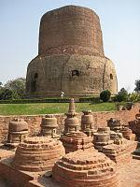
Meaning of stupa
Generally stupa is meant to be a mound of the earth enclosing relics in it.
It is often compared with the form of Great pyramids of Egypt.
It is called thuha in Pali ,yupe in Sanskrit and Daagabh in Simhali language.
Stupa word is derived from Sanskrit word Stu meaning to pray
https://en.wikipedia.org/wiki/Dhamek_Stupa
en.wikipedia.org.wiki/stupa

Slide 9
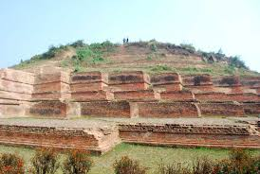
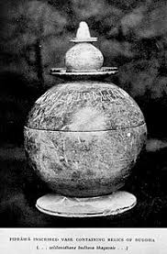
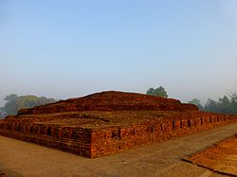
Origin..
Literary sources-
Reference in Rigveda-Shady Tree,The flames of the fire
In Shatpath Brahmin-The Circle of the sun is stated as Hiranya Pinda.
Early Archaeological remains-Louria Nandangarh in Bihar and Piprahwa in Basti,UP
https://www.holidify.com/places/patna/lauriya-nandangarh-sightseeing-8164.html
Buddha Lord"Piprahwa vase with relics of the Buddha. The inscription reads ...salilanidhane Budhasa Bhagavate... "Relics of the
https://en.wikipedia.org/wiki/Piprahwa

Slide 10
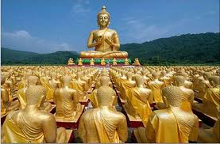
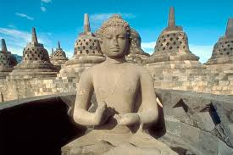
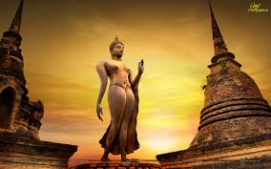
Stupa And Buddhism
Discussion of Ananda And Buddha(Vinay Pitak)
8 stupas came to existance just after the Mahaparinirwana of Buddha which contained relics of buddha----
Magadha King Ajatshatru
Licchavi of Vaishali
Shakya of Kapilvastu
Buliya of Allakappa
Koliya of Ramgama
A brahmin of Vethdeep
Malla of Pava
Malla of Kushinara
Moriya of Pippalivan mada stupa on the ashes of buddha remains
A brahmin Drona made stupa on asthi kalash

Slide 11
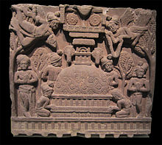
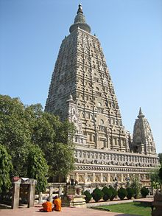
Evolution of Stupas
Stupas evolved over times from simple funerary monument to elaborately decorated object of veneration.
Maurya king Asoka (274-236BCE) is said to have redistributed the relics kept in original stupas into 84000 stupa throughout India.
Some are the stupas of Bharhut ,Sanchi, Sarnath Bodhgaya etc.
https://en.wikipedia.org/wiki/Bharhut
en.wikipedia.org.wiki/stupa
https://en.wikipedia.org/wiki/Dhamek_Stupa
https://en.wikipedia.org/wiki/Mahabodhi_Temple

Slide 12
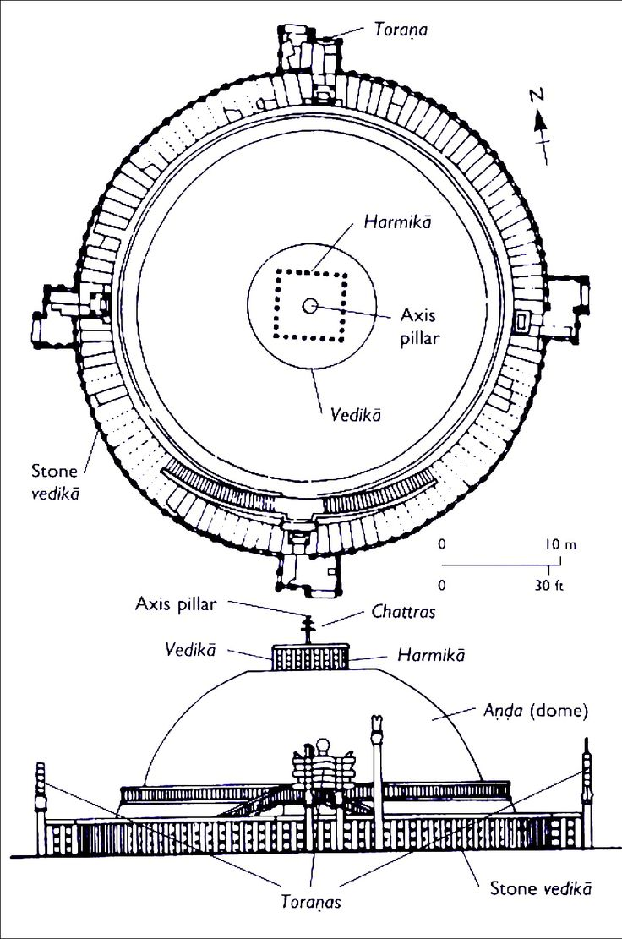
Construction of a stupa
Society took it as hilarious and festive event
The king took great interest
Large stupa called mahachaitiya or maha stupa
Thupkamma-stupa karma =construction
Kammadhithdhayak-karmadhishthapak=the one who construct the stupa
Thupatthan-stupasthan =the place where stupa was going to construct or is constructed
Shilathupa-shilastupa= rockcut stupa
Alpe shakhya and mahe shakhya
https://app.emaze.com/@AQOTIIFC#2

Slide 13
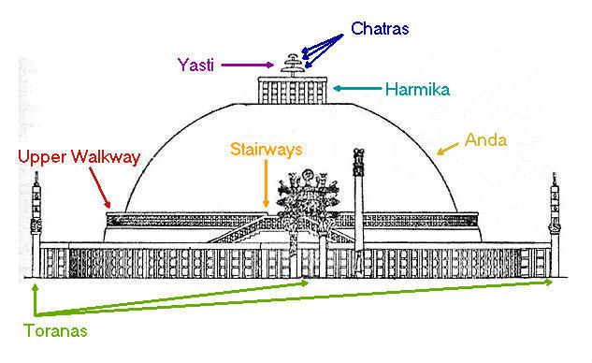
Elements of a stupa
Medhi
Anda
Harmika
Yashti
Chatra
Sopana
Torana
Pradakshina path
https://app.emaze.com/@AQOTIIFC#4

Slide 14
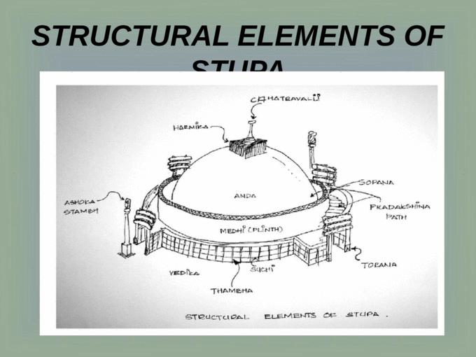
Structure…..

Slide 15
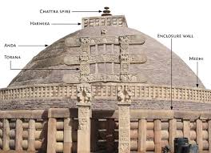
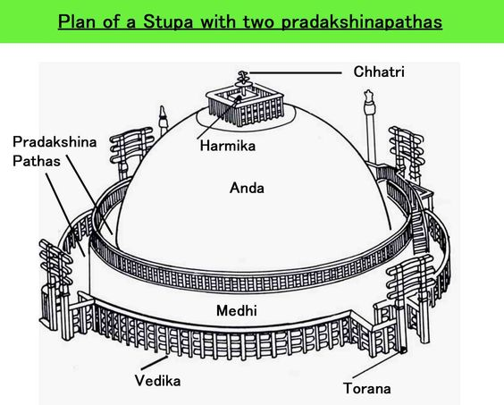
https://www.clearias.com/post-mauryan-art-architecture/

Slide 16
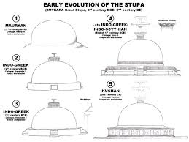
Hinayana or Early phase (c 400BC-250AD)
Mahayana or later phase(c251AD-700AD)

Slide 17
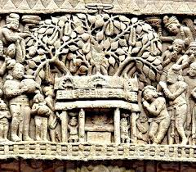
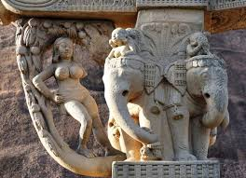
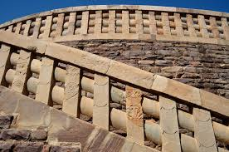
Sculptures
Vedikas and toranas have beautiful carvings
Symbolic buddhist sculptures/Buddha in human form
Historical events
Flora and fauna
Shalbhanjhikas
Demigods and goddesses
Jataka tales
Depiction of social life

Slide 18

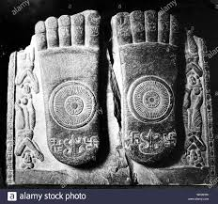
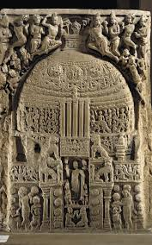
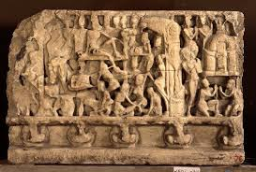
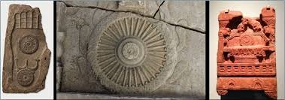
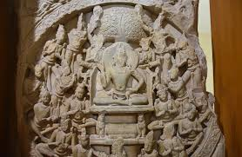
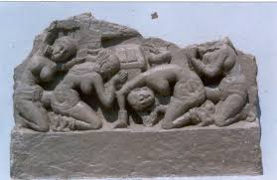
Sculptures

Slide 19
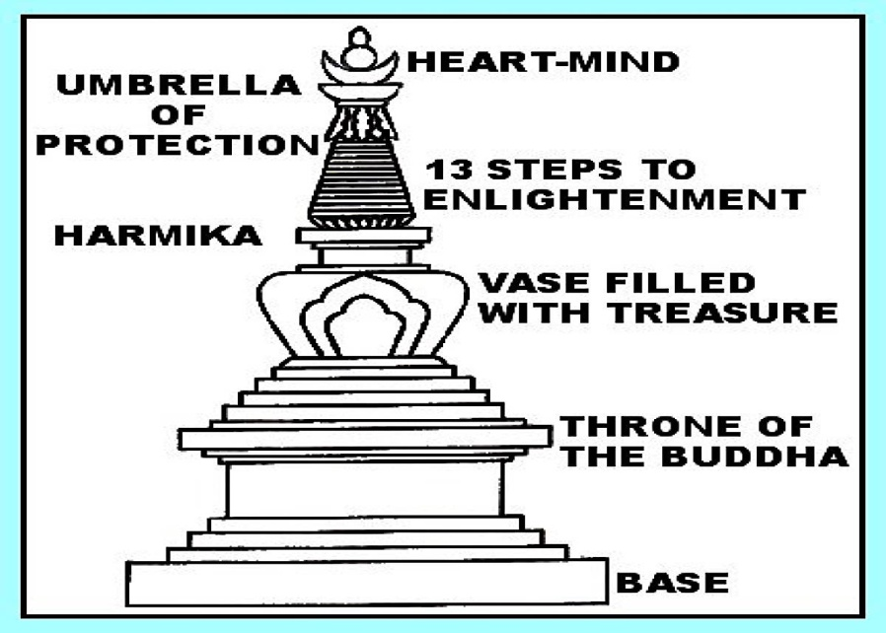
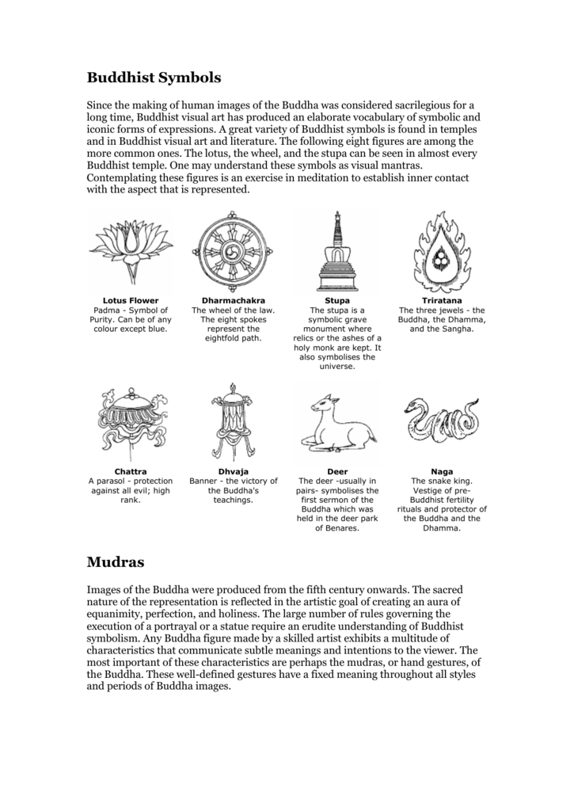
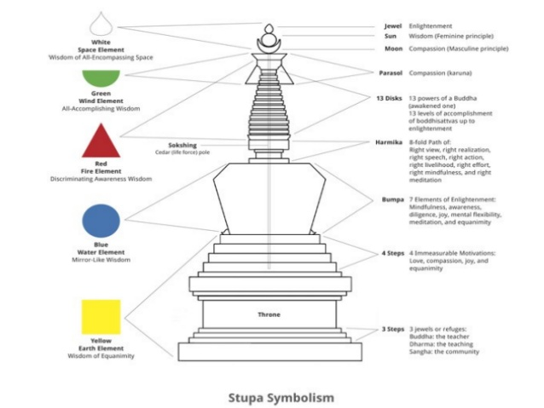
Symbolism
The shape of the stupa represent the Buddha himself
crowned and sitting in meditation posture on a lion throne
His crown is the top of the spire
His head is the square at the spire’s base
His body is a vase shape
His legs are the four steps of the lower terrace
The base is his throne

Slide 20
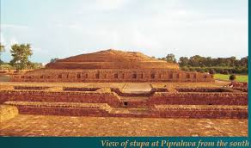
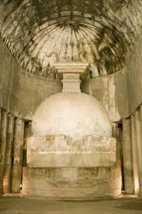
Types of stupas
Relic- Sharirik-the relics of buddha and other religious persons are burried
Object- Paribhougik-Objects belonging to buddha and his disciples are burried
Commemorative –Uddeshik- built to commemorate events of life of buddha and his disciples
Votive-Sankalpit-built to commemorate visits or gain spiritual benefits.
Sarnath stupa
Ajanta cave 10

Slide 21
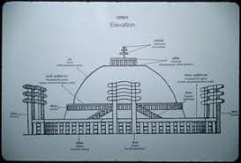
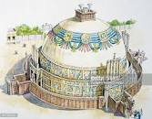
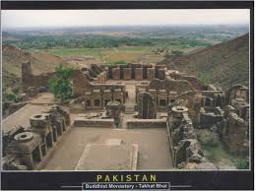
Various Regional Architectural Development of stupas
Central Indian stupa- Sanchi
South Indian stupa –Amravati
North west Indian stupa –Takhte-bahi

Slide 22
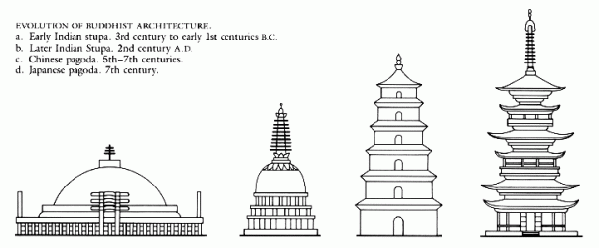
Source: skyscrapercity.com

Slide 23
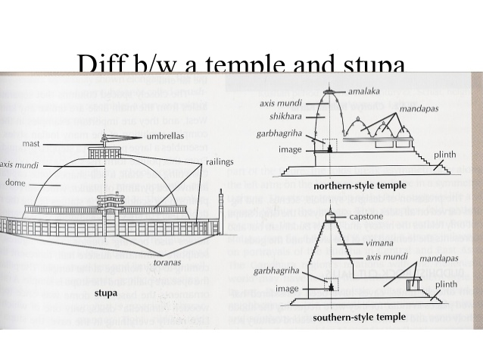
Difference between a Stupa and a Temple

Slide 24
References
Ganguli,O.C- Indian Architecture
Rowland ,B- The Art and Architecture of India
Agarwal ,V.S- Indian Art(Bhartiye Kala in Hindi)
Pandey,J.N- Bhartiya kala evam Puratatva
Learning never ends…..
Gratitude for authorities and the sources ( contents, images and maps etc) used in this PPT
THANK YOU

